Slide 1
INTERNSHIP STUDIO’s Ethical Hacking Internship Project
By: SHREYA PANDEY
Email: csengineerspandey@gmail.com

Slide 2
TASK – 01 Solving vulnerabilities of XSS labs at “Portswigger”

Slide 3
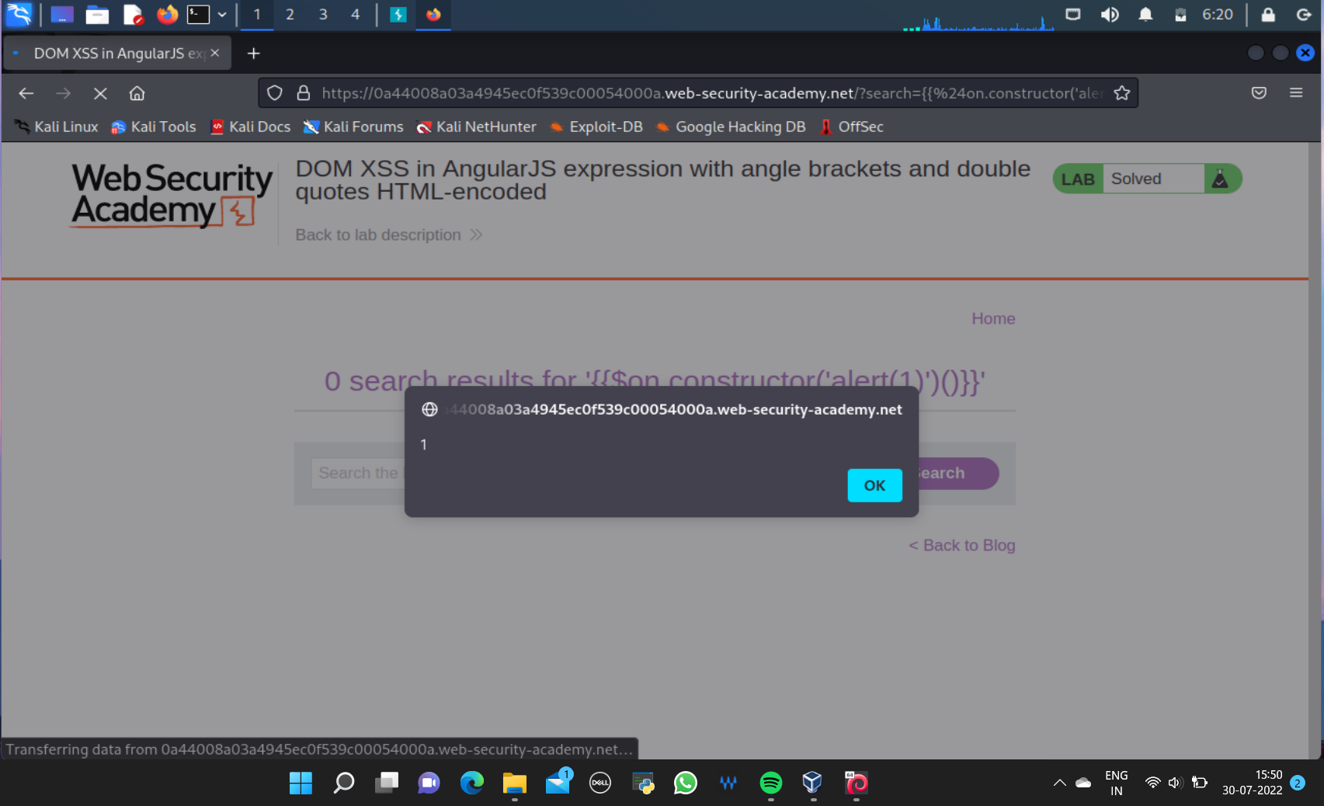

Slide 4
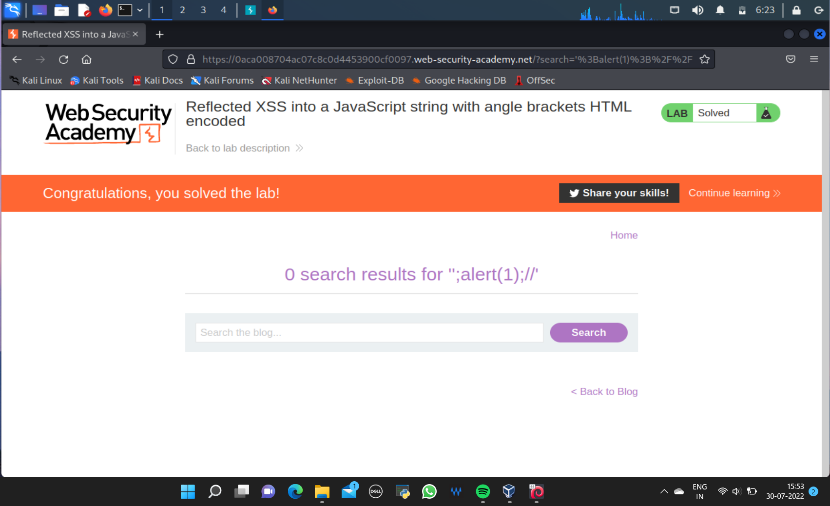

Slide 5
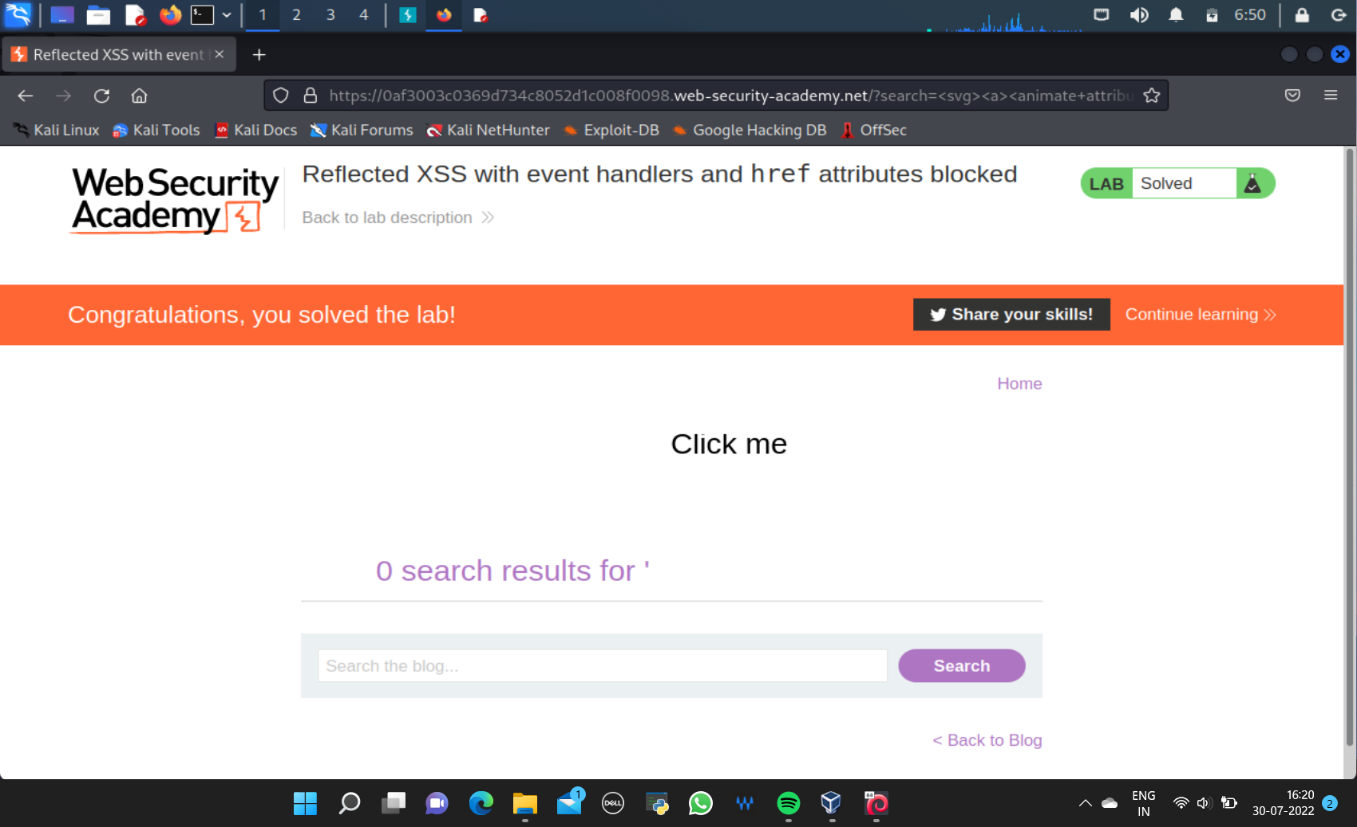

Slide 6
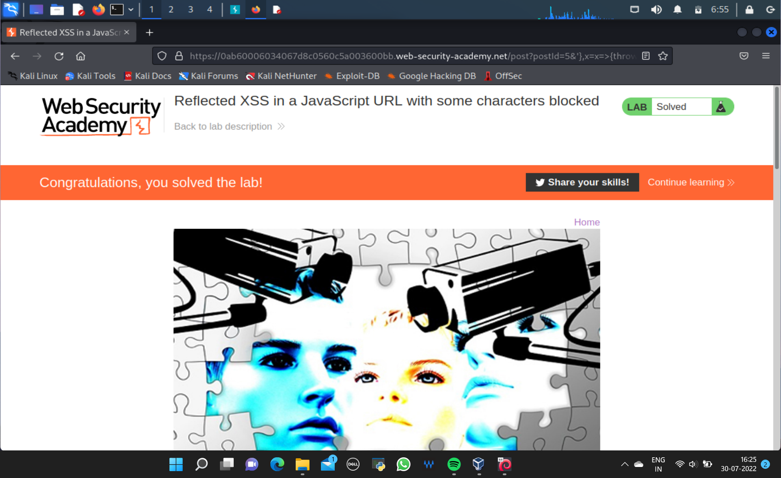

Slide 7
